Slide 1


SMART INDIA HACKATHON 2025
TITLE PAGE
Problem Statement ID – SIH25140
Problem Statement Title- Student Innovation
Theme- Smart Education
PS Category- Software
Team ID- 258
Team Name - Viltrumites

Slide 2

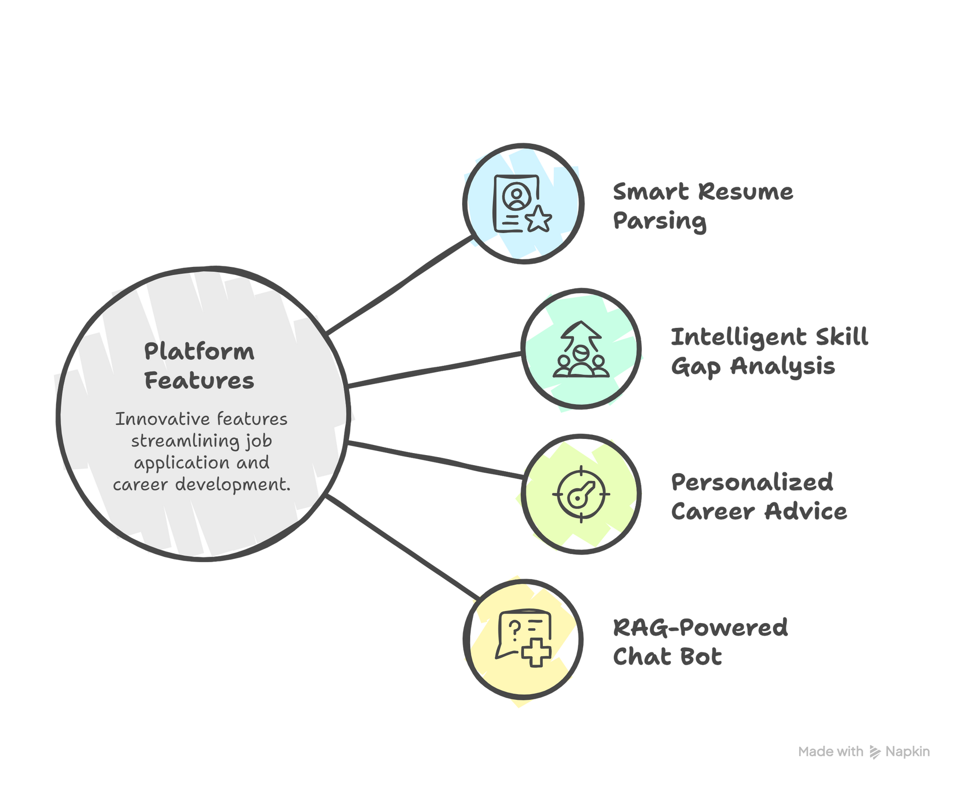


SKILL BRIDGE AI
Viltrumites
Skill Bridge AI –Powered Resume Analysis & Hyper-Personalized Upskilling Roadmap.
The Problem:
Students and Professionals struggle to get personalized career guidance.
Automated skill gap analysis and direct link to free learning resources.

Slide 3
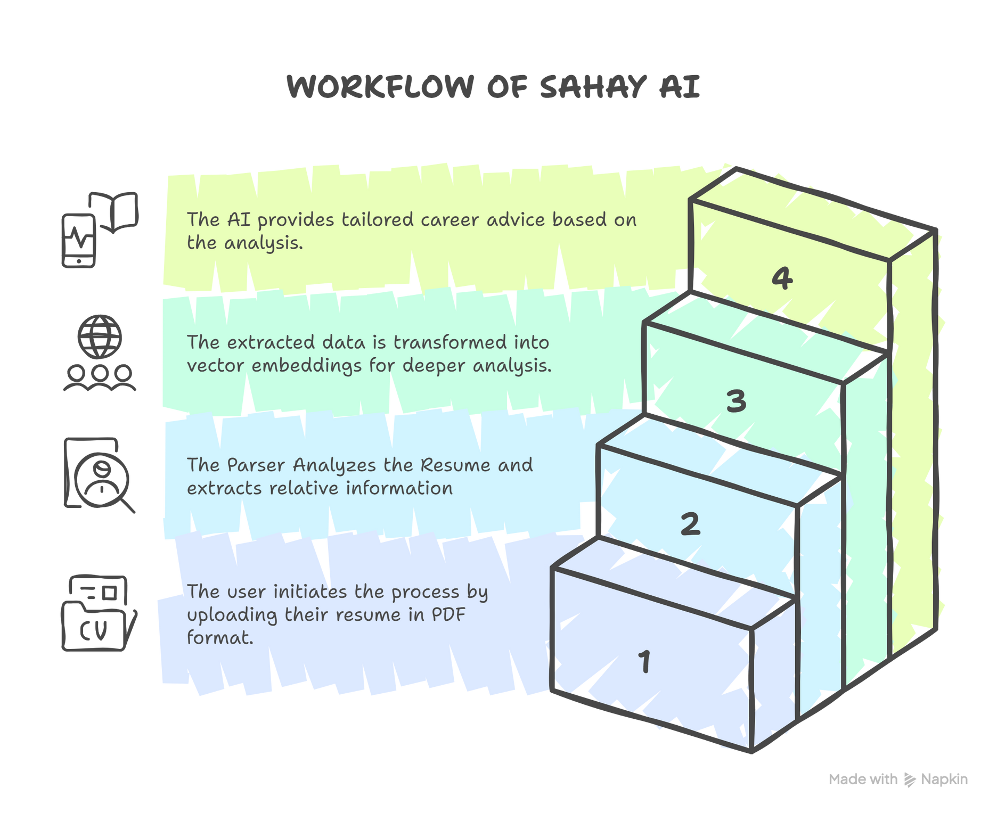
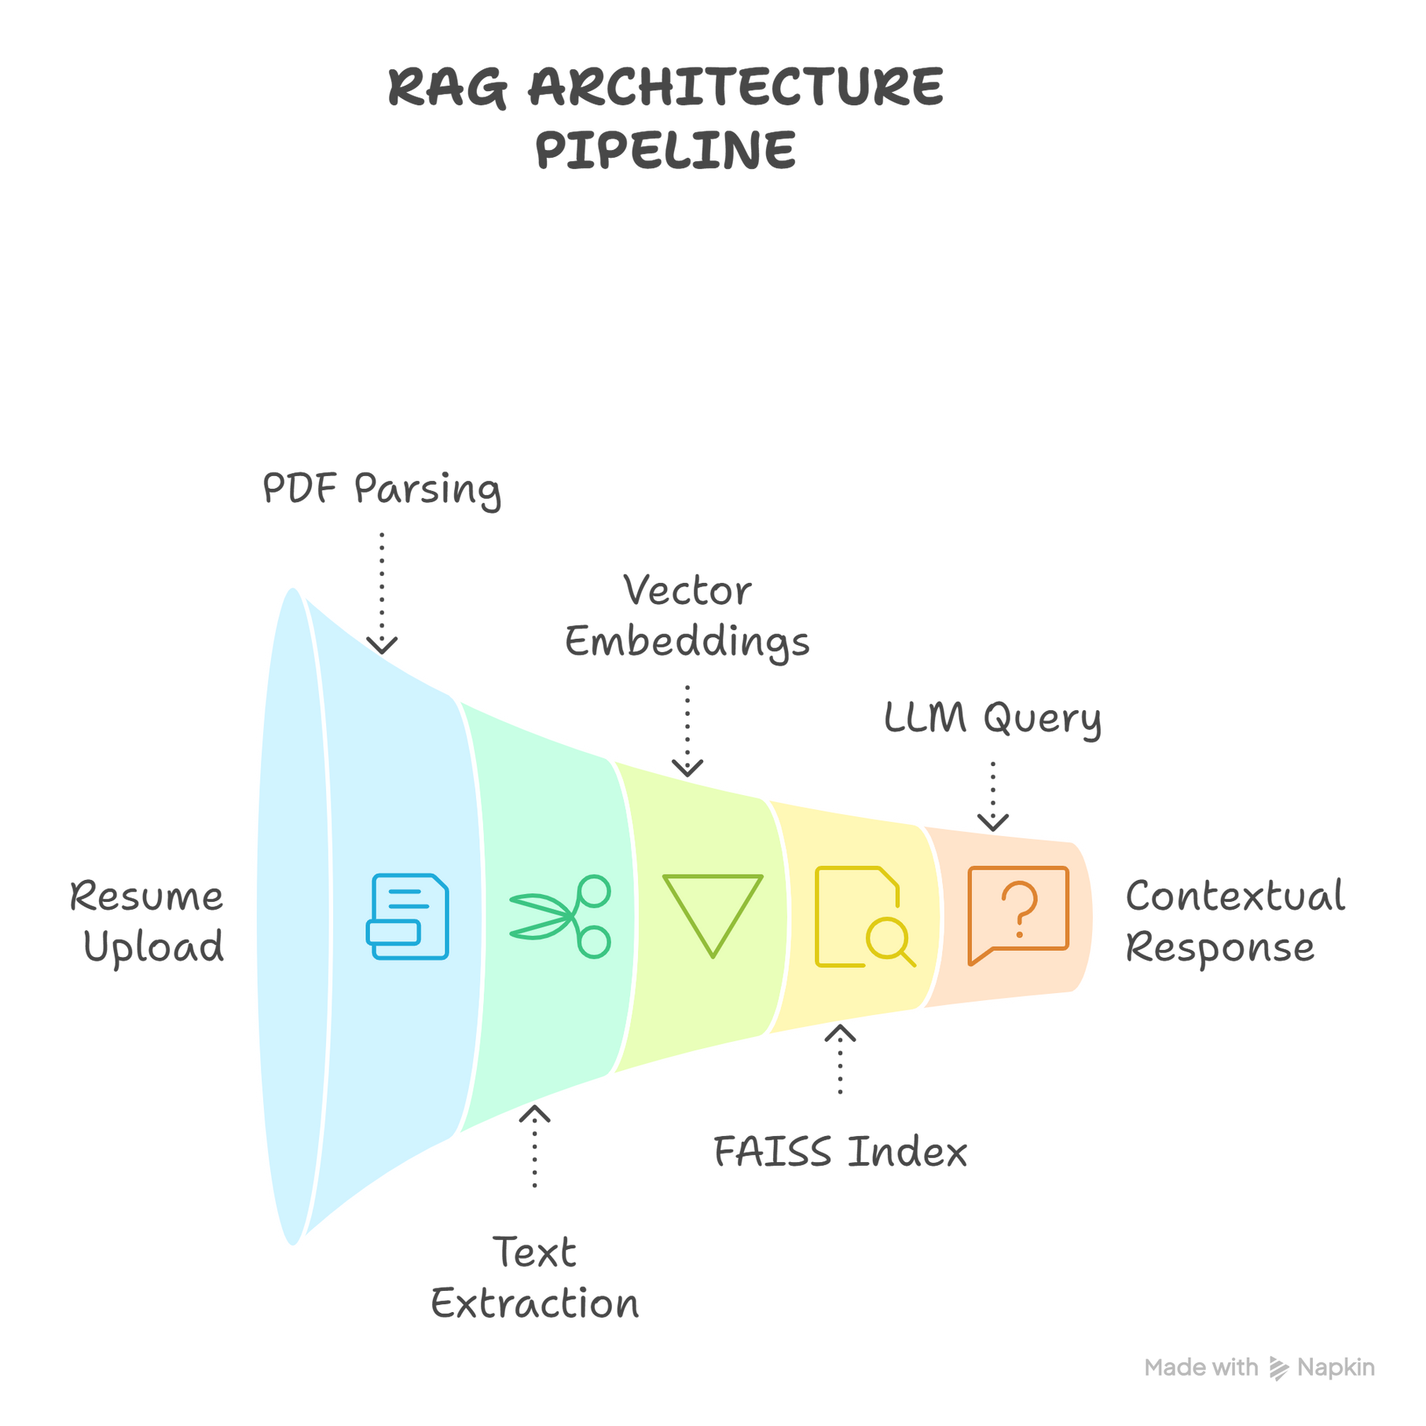
TECHNICAL APPROACH
Viltrumites
Skill Bridge AI
Architecture Pipeline
Technology Stack
Python, RegEx, Web Parsing (for skill lists/links), Flask (for Web App).

Slide 4
FEASIBILITY AND VIABILITY
Viltrumites
Feasibility Analysis
Technical: Achievable via Fast, simple RegEx over complex ML.
Viability
Bridges massive skill gap.
Mitigation Strategies
Use multi-layered RegEx to first extract resume sections.
Potential Challenges & Risks
Resume Format Variation: Complex resume formats can confuse simple RegEx.
Economic: Cost-effective solution using free technologies(RegEx, Youtube).
Highly scalable: democratizes learning via open-source Youtube.
Youtube Link Quality: Risk of low-quality or irrelevant Youtube course recommendations.
Filter course recommendations by video title, length and view count to ensure quality.

Slide 5
IMPACT AND BENEFITS
Viltrumites
Impact
Students
> Personalized roadmap
> Removes guesswork
> Improves motivation
Industry
> Reduces time/cost in training new hires by providing job-ready graduates
Social
Democratizes career guidance for rural/remote students via free, structured courses.
Economic
Reduces student upskilling cost and boosts graduate employability.
Scalability
High-impact model that can easily be scaled to millions of learners.
Future Scope:
Integrate NLP/LLMs for context-aware and soft skill extraction.
Add Job Description Matching for hyper-targeted gap analysis

Slide 6
RESEARCH AND REFERENCES
Viltrumites
References
Skill Gap: For statistics on the skill Gap.
Tech Stack:
Python libraries for Resume Parsing.
Future Scope: Research papers on Skill Extraction using LLMs.
Learning: Articles or studies on the effectiveness of personalized learning.
Skill Gap statistics: Focus, Need for personalization
Technical and algorithmic Validation: Resume parsing , upskilling resources
Market and Impact validation: Skills-based Hiring trends, AI in career guidance

